Slide 1

Introduction to Transport Layer
Lecture 6 | Part 1| CSE421 – Computer Networks
Department of Computer Science and Engineering School of Data & Science

Slide 2

Objectives
our goals:
understand principles behind transport layer services:
reliable data transfer, segmentation, flow control etc..
learn about Internet transport layer protocols:
UDP: connectionless transport
TCP: connection-oriented reliable transport

Slide 3
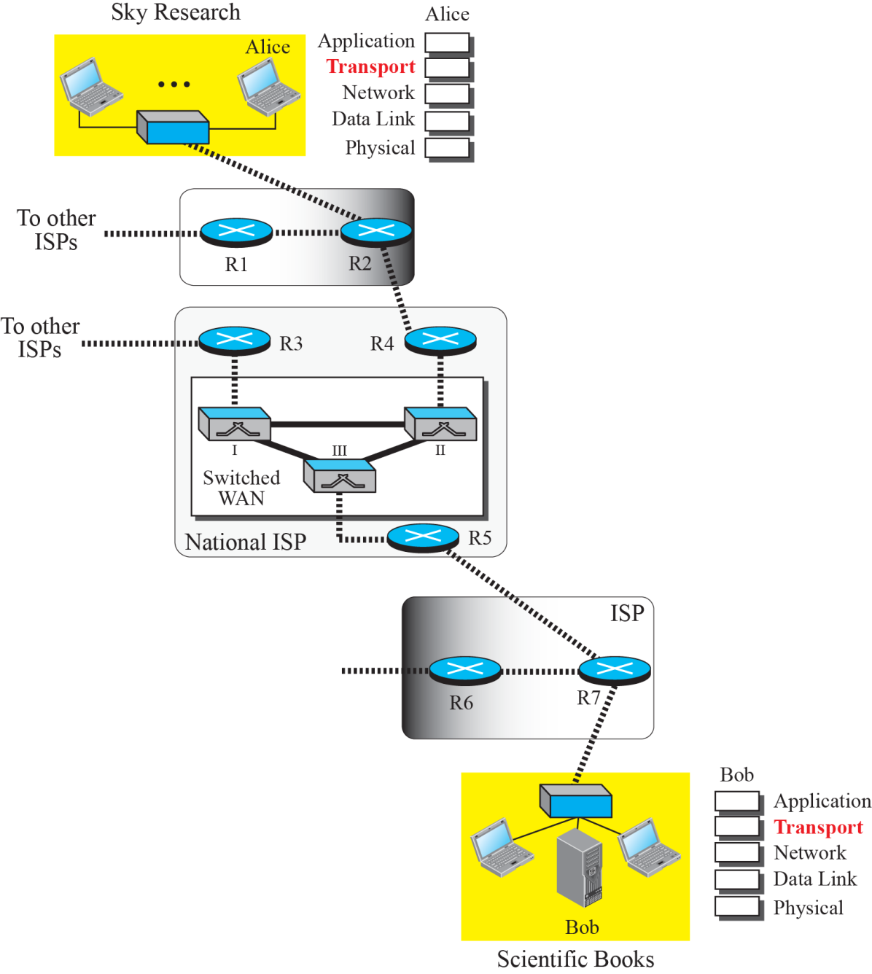
Introduction
The transport layer is located between the application layer and the network layer.
It provides a process-to-process communication between two application layers, one at the local host and the other at the remote host.
Communication is provided using a logical connection. Figure 2 shows the idea behind this logical connection.
Figure 2: Logical connection at the transport layer

Slide 4
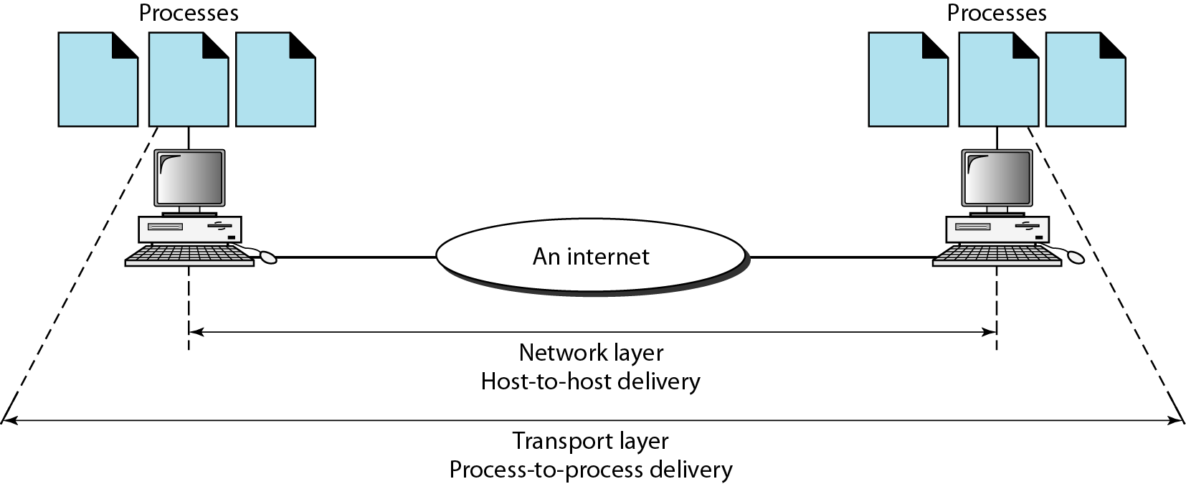
Transport Layer
The transport layer is responsible for the delivery of a message from one process (sender) to another (receiver).
Transport Layer PDU is called Segments
Functions:
Segmentation and Reassembly
Adds Port Address and Sequence Number.
Connection Control
Flow and Error Control
Multiplexing
*PDU – Protocol Data Unit

Slide 5
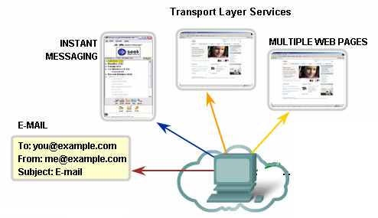
Function – Identification Using Port Address
Port Numbers/Addresses are used to identify different applications/processes running in a computer
16-bit in length
Represented as one single decimal number
e.g. 80 – Web; 23 – Telnet; 25 – SMTP

Slide 6
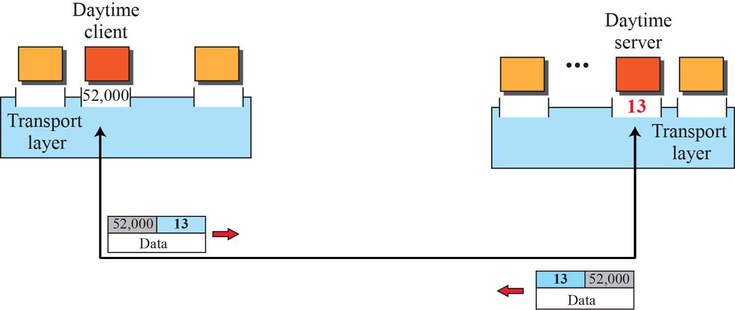
Identifying different applications
Figure 3: Assign Port numbers
Clients can use any random port number, servers can’t.
Because clients won’t be able to identify server process otherwise
Servers, however, cannot use any random port number
Use of well-known port numbers!

Slide 7
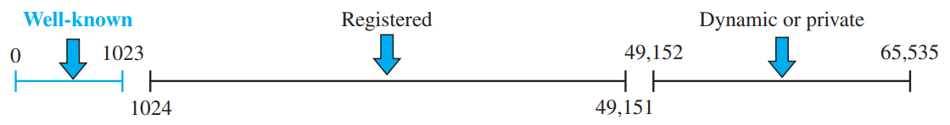
Port numbers
Figure 4: ICANN ranges
Well-known ports: The ports ranging from 0 to 1023 are assigned and controlled by ICANN. These are the well-known ports.
Registered ports: The ports ranging from 1024 to 49,151 are not assigned or controlled by ICANN. They can only be registered with ICANN to prevent duplication.
Dynamic ports: The ports ranging from 49,152 to 65,535 are neither controlled nor registered. They can be used as temporary or private port numbers.
https://www.iana.org/assignments/service-names-port-numbers/service-names-port-numbers.xhtml

Slide 8
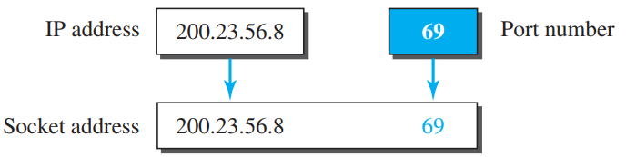
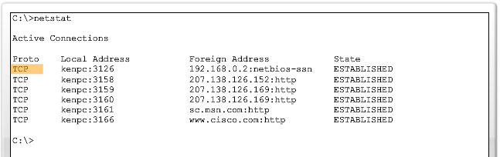
Socket address
IP and Port together is called a Socket Address
To use the services of the transport layer in the Internet, we need a pair of socket addresses: the client socket address and the server socket address.

Slide 9
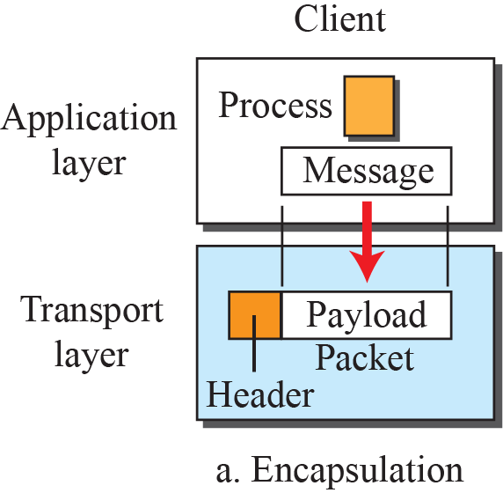
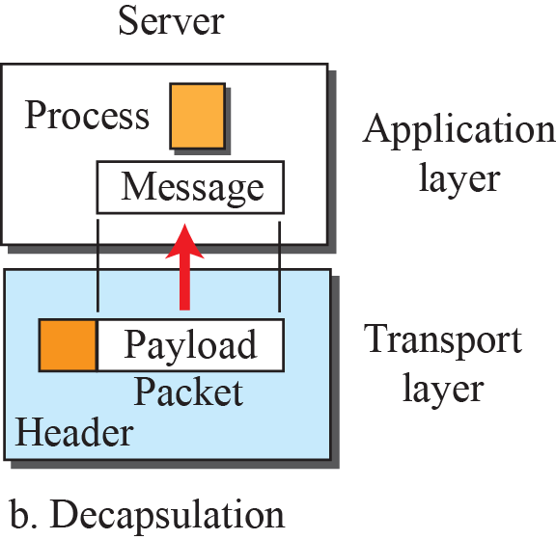

Encapsulation and decapsulation
Figure 5: Encapsulation and decapsulation

Slide 10
Functions – Segmentation/Reassembly
Segments data received from application layer into small parts
Steps (Sender):
Segments into small parts
Add a number to identify the application
Add a number sequence the segmented parts
What do you think will happen at the Receiver end?
Uses the sequence number to order them sequentially, merges them and sends to the upper layer
H5
Data
Segments:
H4
D_1
H4
D_2
H4
D_3
H3
D_41
H3
D_42
H3
D_43
Legend
Session Layer
Transport Layer
Network Layer

Slide 11
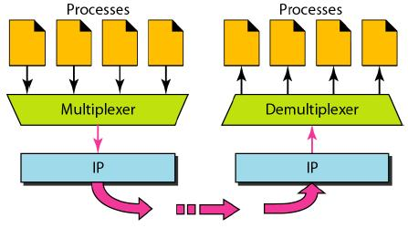
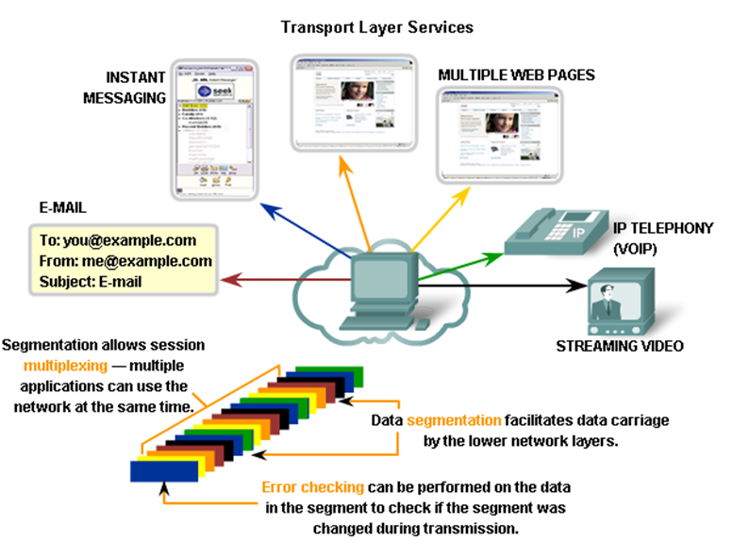
Function – Multiplexing and Demultiplexing

Slide 12
Function – Connection Control
Establishes secure connection (TCP – Three Way Handshake)
Are you up?
Yes
1
2
3

Slide 13
Function – Error Control
Please send Packet 2
Lost in transition
1
2
3
2
2

Slide 14
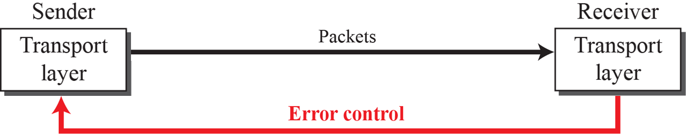
Error Control
Figure 9: Error control at the transport layer
Detecting and discarding corrupted packets.
Keeping track of lost and discarded packets and resending them.
Recognizing duplicate packets and discarding them.
Buffering out-of-order packets until the missing packets arrive.

Slide 15
Transport Layer
Lecture 6 | Part 2

Slide 16
Function – Flow Control
At this point, this host has too many packets to process. Hence, the buffer to store incoming packets overflows.
Please, send less packets
1
2
3

Slide 17
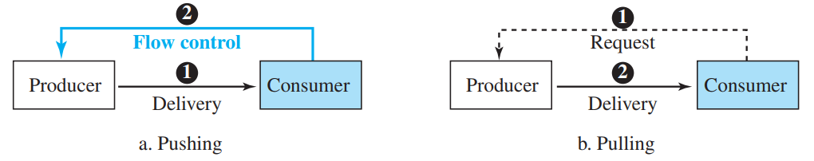
Pushing and Pulling
Figure 7: Pushing or pulling technique
Pushing
If the sender delivers items whenever they are produced, without a prior request from the consumer, the delivery is referred to as pushing
Consumer tells producer to send/stop based on its buffer memory status
Pulling
If the producer delivers the items after the consumer has requested them, the delivery is referred to as pulling
No need of flow control

Slide 18
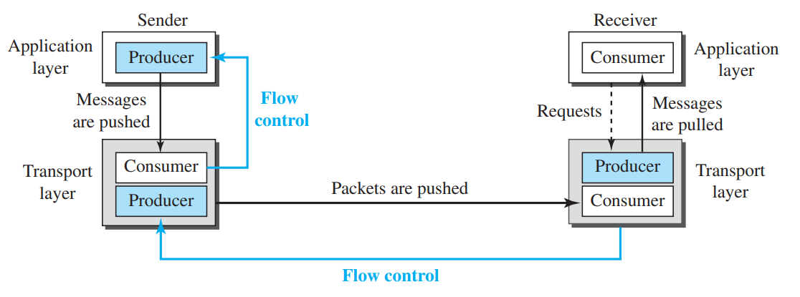
Flow Control
Figure 8: Flow control at the transport layer
Buffer memory of the consumer plays a crucial part in flow control

Slide 19
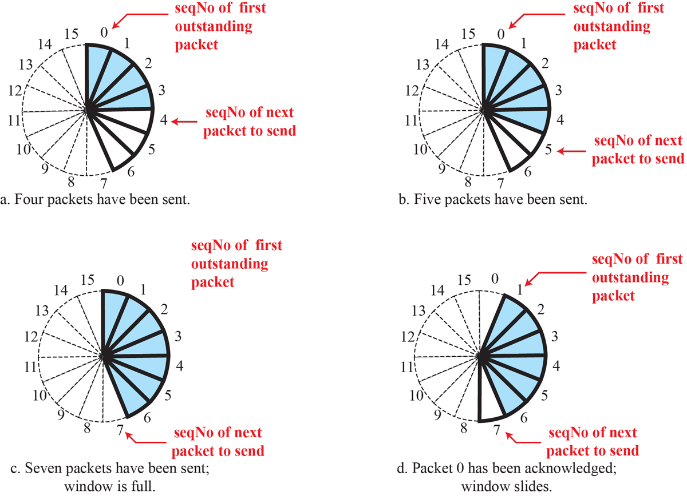
Flow Control
Figure 10: Sliding window in circular format

Slide 20
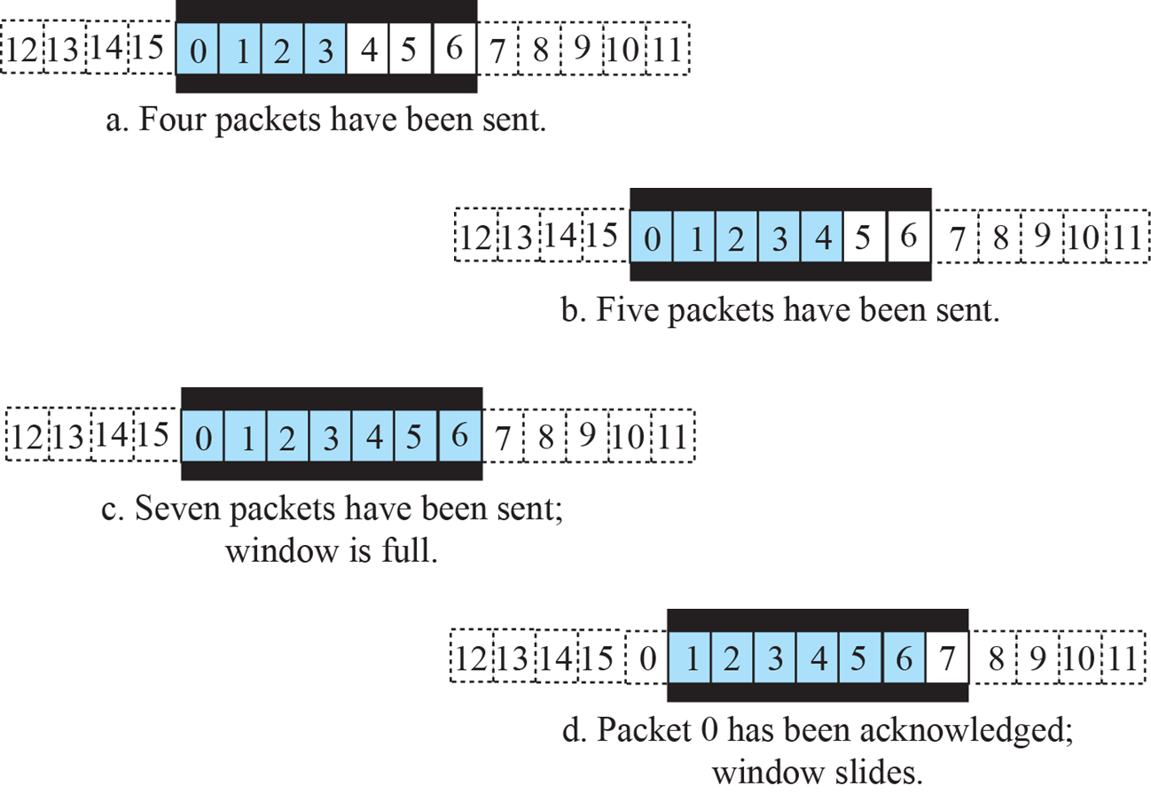
Flow Control
Figure 11: Sliding window in linear format

Slide 21
Transport layer protocols
Transmission Control Protocol (TCP)
User Datagram Protocol (UDP)

Slide 22
Transmission Control Protocol (TCP)
TCP is a connection-oriented, reliable protocol that has flow and error control. It uses port numbers to track and multiplex data received from the application layer.

Slide 23
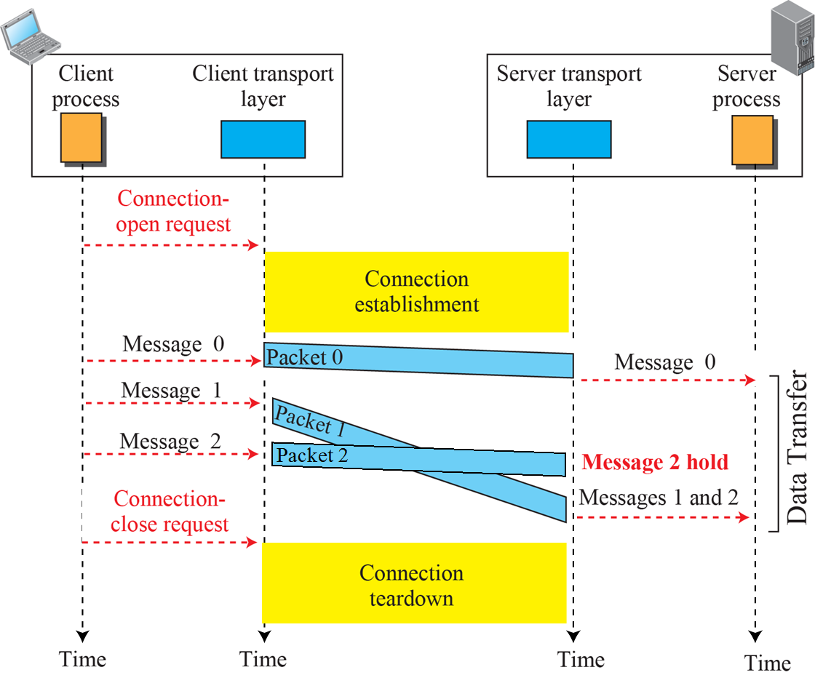
TCP: Connection Oriented Service
Figure 12: Connection-oriented service

Slide 24
User Datagram Protocol (UDP)
UDP is a connectionless, unreliable protocol that has no flow and error control. It uses port numbers to track and multiplex data received from the application layer.

Slide 25
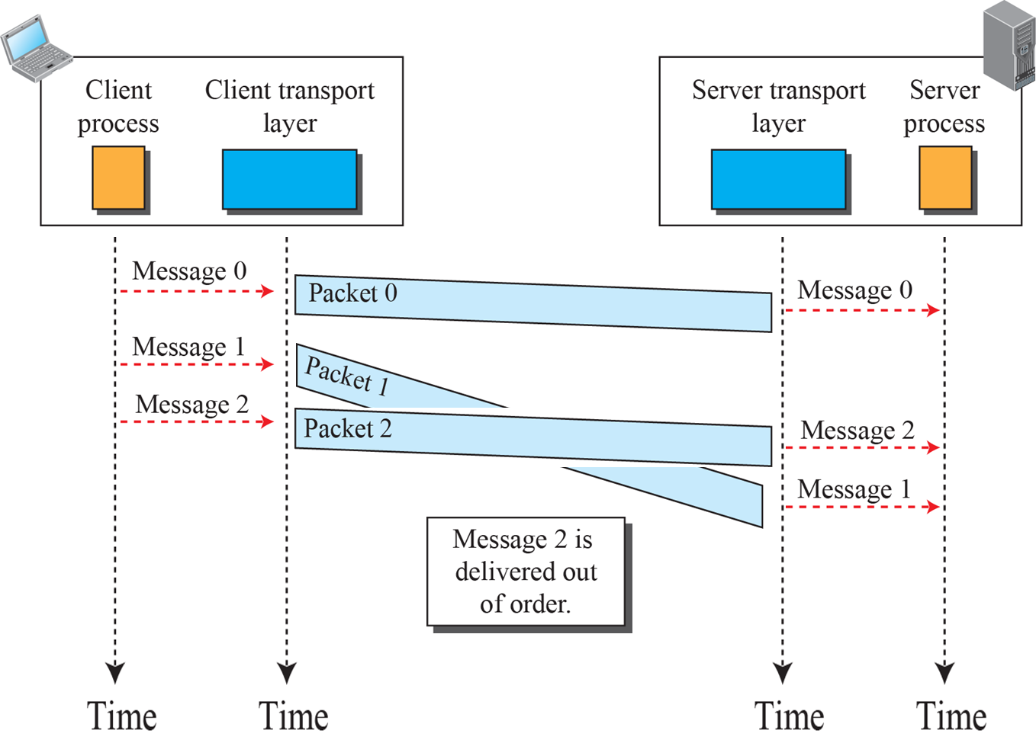
UDP: Connectionless Service
Figure 13: Connectionless service

Slide 26
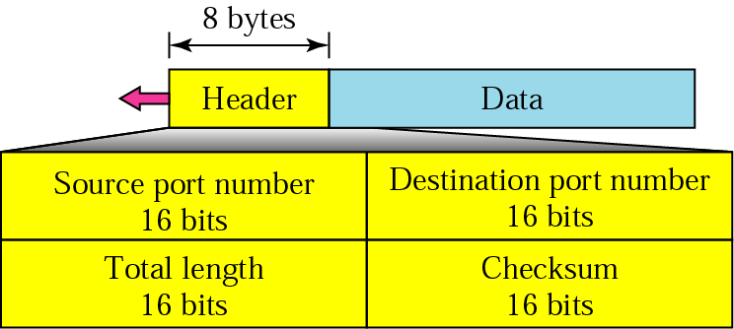
User Datagram Protocol (UDP)
Figure 14: User Datagram Header format
Connectionless
No reassembly to order.
No Error checking
No Flow control

Slide 27
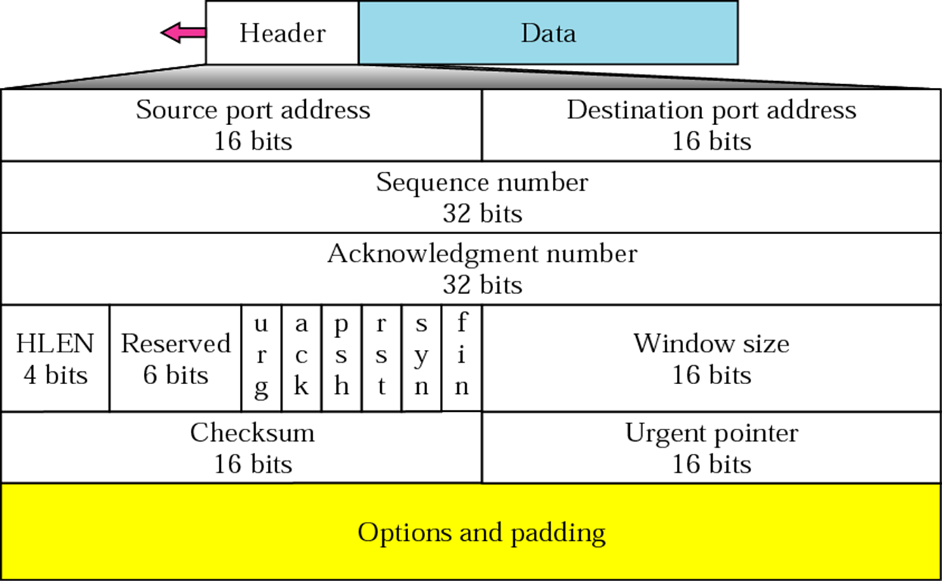
Transmission Control Protocol (TCP)
Figure 15: TCP Header format

Slide 28
Transmission Control Protocol (TCP): Flag bits details
URG: Urgent Pointer. Setting priority of the packet.
ACK: Used for the acknowledgment.
PSH: Push Function. This tells an application that the data should be transmitted immediately and that we don’t want to wait.
RST: Resetting connection. Must terminate the connection right away. This is only used when there are unrecoverable errors.
SYN: We use this for the initial three way handshake and it’s used to set the initial sequence number.
FIN: This finish bit is used to end the TCP connection. TCP is full duplex so both parties use the FIN bit to end the connection.

Slide 29
TCP vs. UDP
Sets up a connection with the receiving host before sending data.
Checks if segments have arrived and resends if they were lost. (Reliability)
Sorts segments into the right order before reassembling the data.
Sends at a speed to suit the receiving host. (Flow control)
High overhead (20 bytes header)
Used for Emails, Web Browsing, FTP, Telnet etc.
Connectionless. Does not contact receiving host before sending data.
Does not check if data arrived and does not re-send. “Best effort”.
Does not sort into the right order.
No flow control.
Low overhead (8 bytes header)
Used for VoIP, streaming video, DNS, TFTP, DHCP etc

Slide 30
THE END

